Slide 1
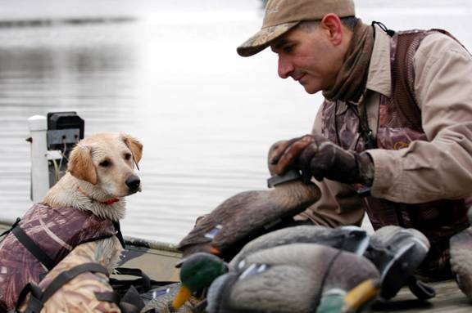
Waterfowl Hunting and Boating Safety
Copyright 2019 - Coast Guard Auxiliary Association, Inc.

Slide 2
Why this Seminar?
Most boating accidents happen in an open motorboat 16 feet or less in length.
1/3 of people who die on the water die while hunting or fishing.
86% of hunters who die in boating accidents are NOT wearing a life jacket.
47% did not even have a life jacket on board the boat.
Copyright 2019 - Coast Guard Auxiliary Association, Inc.

Slide 3
Why this Seminar?
70% of hunters who die in boating accidents fall overboard as a result of improperly loading the boat, moving around a small boat unsafely, or having a hunting dog moving around too much.
Hunters are more likely to die from drowning than an accidental gunshot wound.
Copyright 2019 - Coast Guard Auxiliary Association, Inc.

Slide 4
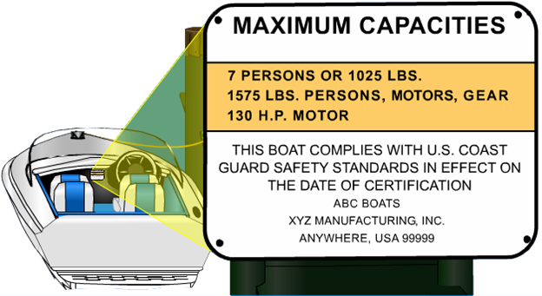
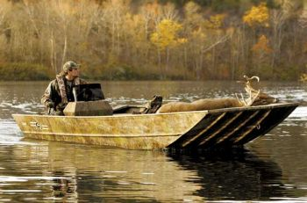
Boat Loading: Capacity Plate
Why is this important?
Copyright 2019 - Coast Guard Auxiliary Association, Inc.
Notes:
Instructor Notes: Discuss that safe boat handling means knowing your vessel’s limits
ASK: What could happen if the information on the Capacity Plate was ignored?
Discuss: Federal law is: all single hull boats less than 20’ (except sailboats and PWC) must have one

Slide 5
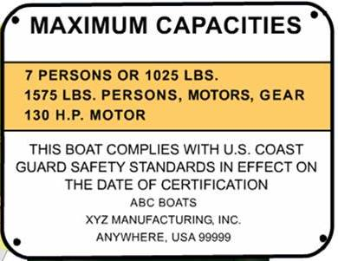
Capacity
Weight limit is as important as number of persons.
Include hunting dogs.
1025 lbs. / 7 persons = 146 lbs./person.
1575 lbs. includes everything (except weight of the hull): motor, fuel, oil, battery, anchor, decoys, guns, food, ice chest, people, dogs, etc.
Copyright 2019 - Coast Guard Auxiliary Association, Inc.
Notes:
Instructor Notes: mention that 4 people weighing 210 lbs (including foul weather clothing and PFDs) plus 2 hunting dogs at 100 lbs each puts you over the weight limit.
Note that the weight of a 130 HP motor alone can be around 450 lbs, not including steering linkage, oil, gas, battery, etc.
Mention that overloaded boats can swamp or capsize more easily and will be more difficult to control.

Slide 6
Capacity
Motor HP limit is as important as other limits.
If Too Large:
Boat difficult to handle;
Can cause boat to flip;
Low Transom can take on water.
Copyright 2019 - Coast Guard Auxiliary Association, Inc.
Notes:
Instructor Notes:
Note that the weight of a 130 HP motor alone can be around 450 lbs. Larger motor causes boat to be stern heavy and can swamp or capsize more easily and will be more difficult to control.

Slide 7
Capacity
What if your boat does not have a capacity plate?
Formula to estimate capacity:
(length X width) ÷ 15 = est. # of persons
(est. # persons) X 150 = est. total weight
Note: length & width in feet
Note: All fractional values reduced to lower whole number
Copyright 2019 - Coast Guard Auxiliary Association, Inc.
Notes:
Instructor Notes: This is a very liberal estimate of capacity.

Slide 8
Float Plans
What is a Float Plan?
What information does it contain?
Copyright 2019 - Coast Guard Auxiliary Association, Inc.
Notes:
Instructor Notes.
Discuss the information contained on one.
Ask: Who would you give this float plan to?
Ask: Why is this an important part of boating

Slide 9
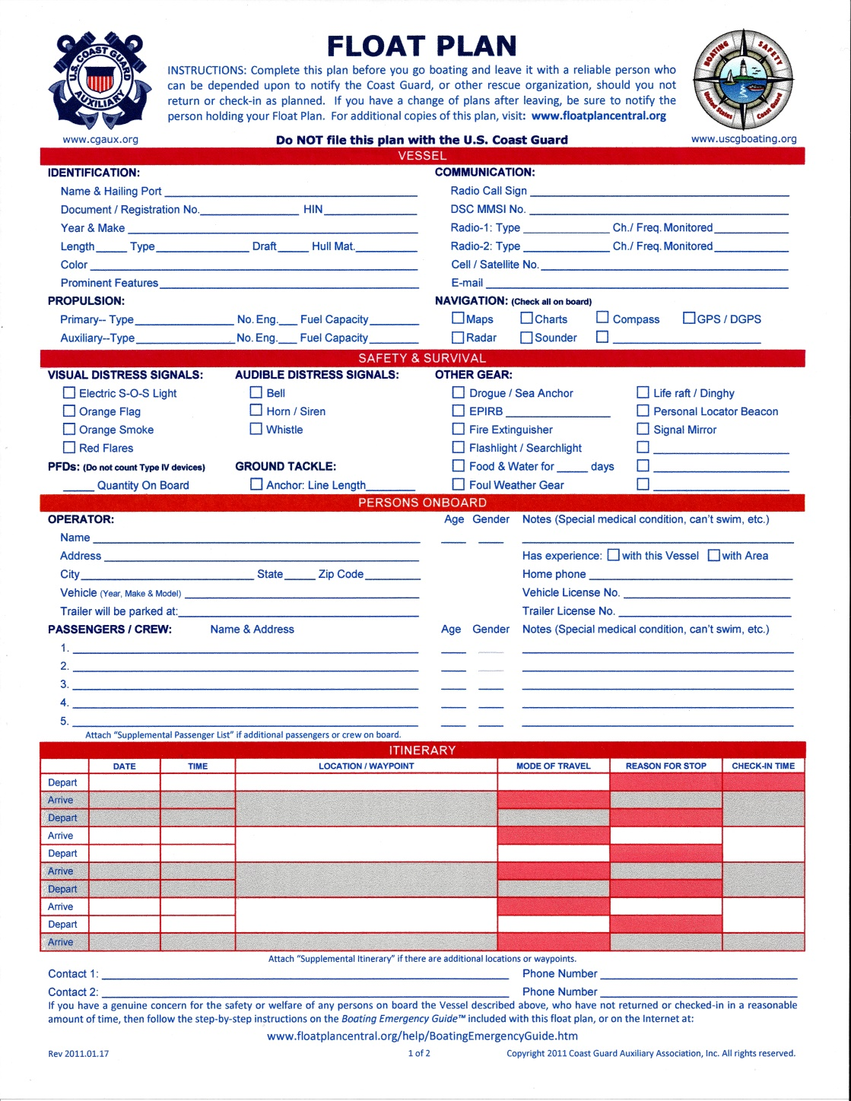
www.floatplancentral.cgaux.org
Copyright 2019 - Coast Guard Auxiliary Association, Inc.
Notes:
Show (and distribute if you have them) copy of USCG Float Plan and point out information on form.
Discuss the information contained on one.
Ask: Who would you give this float plan to?
Ask: Why is this an important part of boating?
Note: Students can download pdf copy from website listed.

Slide 10
Float Plan
Information Recommended:
Description of boat & Reg. #
Description of vehicle & license plate #
Your name & cell phone #
Launch location & est. time of launch
Number of & names of boaters & dogs
Hunting location as specific as possible
“If not back by (list time) call for help”
Phones #s for local law enforcement
Give this to responsible family member or friend
Copyright 2019 - Coast Guard Auxiliary Association, Inc.
Notes:
Instructor Notes:
Ask: Who would you give this float plan to?
Ask: Why is this an important part of boating

Slide 11
Coast Guard APP
Apple and Android Phones
Copyright 2019 - Coast Guard Auxiliary Association, Inc.
Notes:
Instructor Notes:
Explain about the Coast Guard. Available FREE download. Allows for online filing of Float Plans. Explain all the menu items and advantages of downloading this APP to their phones.

Slide 12
Safe Loading
Keep centered in small boats
One hand for you, one hand for the boat
Load gear from the dock
Step into the center of the boat, never on the gunwale
Never overload
Copyright 2019 - Coast Guard Auxiliary Association, Inc.
Notes:
Instructor Notes:
Ask: Why are these important? What could be the result of not heeding these suggestions?
ASK: What would happen if you loaded people or gear into a small boat by stepping on the gunwale?

Slide 13
Balancing the Load
Keep load centered in small boats.
Unbalanced load makes boat difficult to handle and susceptible to swamping or capsizing.
What appears balanced when stopped may not be when underway.
Stop boat periodically to adjust load.
Don’t allow dogs to move around freely while underway.
Copyright 2019 - Coast Guard Auxiliary Association, Inc.
Notes:
Instructor Notes:
Ask: Why are these important? What could be the result of not heeding these suggestions?

Slide 14
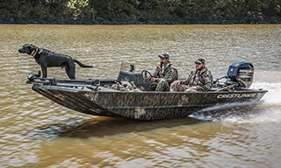
Maneuvering
Turning
Slow, controlled speed
Backing
Slowly, stern may veer
Stopping
Requires distance
Slowly to avoid stern wave
Copyright 2019 - Coast Guard Auxiliary Association, Inc.
Notes:
Instructor Notes:
Ask: What could happen if turns were made at a high rate of speed?
Capsize, or eject passengers.
Ask: Why should you always back the boat slowly?
Too fast may swamp the boat.
Ask: What safety issues are involved in stopping your boat?
May require several times the boat length
Too fast may swamp your boat

Slide 15
Anchoring Guidelines
Why use chain?
What is scope?
Copyright 2019 - Coast Guard Auxiliary Association, Inc.
Notes:
Instructor Notes:
Discuss the two questions:
Responses:
Chain help keeps the anchor flukes flat.
Scope is the ratio of rode length to the depth of water.
Note to students: The anchor rope and chain is called the anchor rode in nautical terms.
Classroom aid: bring a small anchor and rode to demonstrate how the scope will keep the anchor flat.

Slide 16
Anchoring Guidelines
Normal Scope 7:1
Calm Seas 5:1
Heavy Weather 10:1
Copyright 2019 - Coast Guard Auxiliary Association, Inc.
Notes:
Instructor Notes:
Ask: Why is more scope needed in heavy weather?

Slide 17
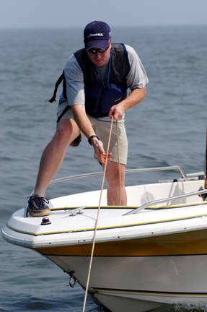
Setting Anchor
What steps are involved?
Approach into wind/current.
Lower (don’t throw) anchor.
Pay out line while backing.
Secure line to cleat.
Back down to set anchor.
Periodically check for drift.
Copyright 2019 - Coast Guard Auxiliary Association, Inc.
Notes:
Instructor Notes:
Ask: the question on the chart.
Discuss:
Select sheltered area
Approach into wind/current
Slowly lower anchor
Pay out scope while backing down
Make line fast; back down to set
Check for drift using landmarks
Why is it unwise to anchor from the stern?

Slide 18
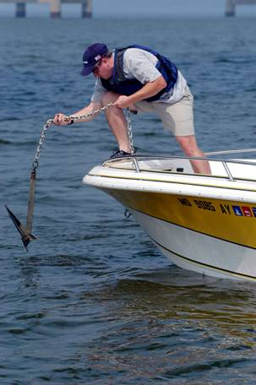
Retrieving Anchor
What steps are involved?
Slowly move ahead while
taking in the line.
Don’t over run anchor line.
If anchor is stuck secure
the line to bow cleat and
power around in a circle.
Copyright 2019 - Coast Guard Auxiliary Association, Inc.
Notes:
Instructor Notes:
Ask: the question
Discuss:
Slowly move ahead while pulling in line.
If anchor sticks, power around in a circle.

Slide 19
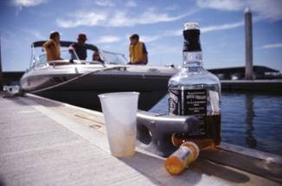
Alcohol and Drugs
Alcohol and Drugs Never Mix with Boating and Hunting
What are the dangers of boating/hunting under the influence?
Contributes to 1/3 of boating accidents.
What are the laws in your
state regarding boating
and drinking?
Copyright 2019 - Coast Guard Auxiliary Association, Inc.
Notes:
Instructor Notes:
Discuss:
The effects of alcohol and drugs
Effects made much worse by the factors involved with boating:
Noise
Sun
Vibrations
Wind and seas

Slide 20
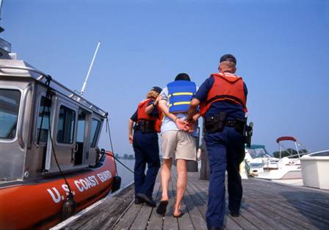
Alcohol and Boating Don’t Mix
What happens if a person uses alcohol
While operating a boat?
Why is alcohol intensified on the water?
Copyright 2019 - Coast Guard Auxiliary Association, Inc.
Notes:
Instructor Notes:
Discuss the legal limits of alcohol consumption for your particular state.
Remind the participants that using drugs and/or alcohol while boating is a leading cause of boating accidents. Be sure to discuss the added dangers of alcohol use when hunting because of use of firearms on board the boat.

Slide 21
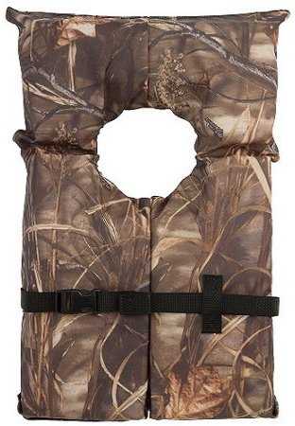
Life Jackets
86% of hunters who die in boating accidents are NOT wearing a life jacket.
47% did not even have a life jacket on board the boat.
Copyright 2019 - Coast Guard Auxiliary Association, Inc.

Slide 22
Life Jackets
Legal Requirements:
Must be Coast Guard approved
Must have one properly fitting Type I, II, III, or V life jacket for each person on board.
If vessel over 16 feet, must have a Type IV throwable.
Must be in serviceable condition.
Must be readily accessible (preferred worn).
Copyright 2019 - Coast Guard Auxiliary Association, Inc.

Slide 23
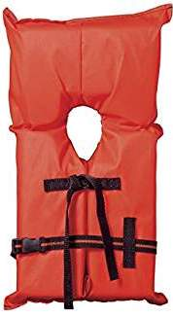
Life Jackets
Type II:
Near-Shore Vest
Minimum
buoyancy
15.5 pounds
Copyright 2019 - Coast Guard Auxiliary Association, Inc.
Notes:
Instructor Notes:
Discuss the properties of this type of PFD.
Turns some unconscious wearers face-up in the water.
Available in different sizes

Slide 24
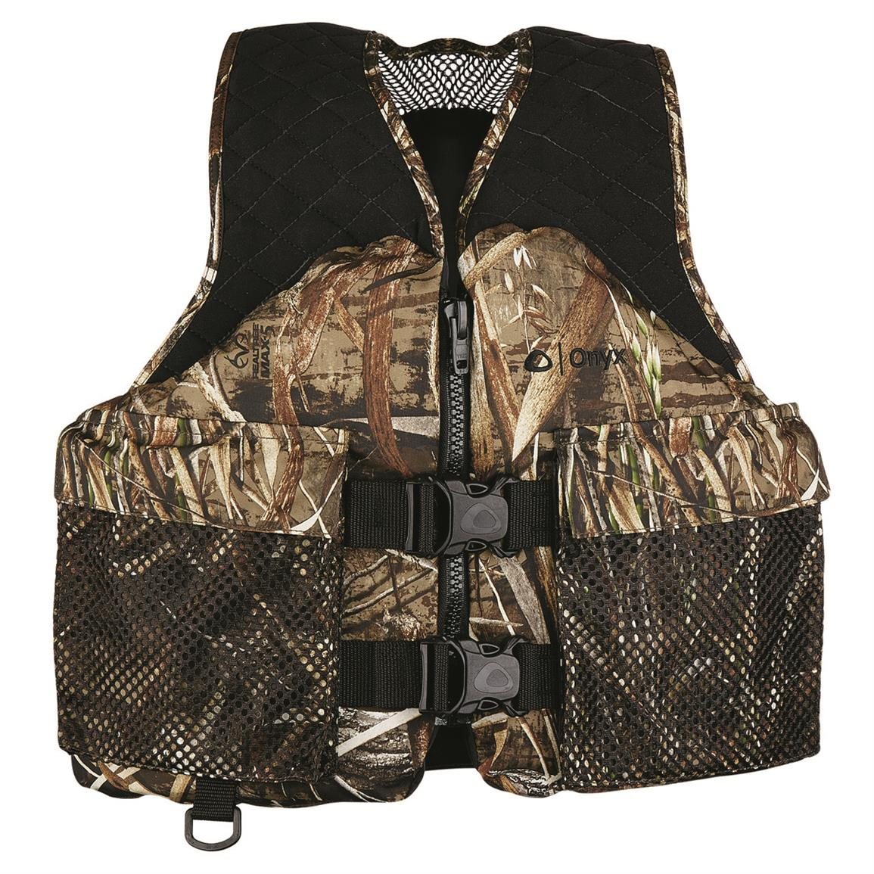
Life Jackets
Type III:
Life Jacket
Minimum
buoyancy
15.5 pounds
Copyright 2019 - Coast Guard Auxiliary Association, Inc.
Notes:
Instructor Notes:
Discuss the properties of this type PFD:
Emphasize the ease and comfort of wear vs. Type II
May need to tilt head to keep face out of water
Available in different sizes

Slide 25
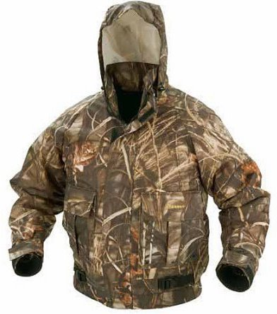
Life Jackets
Type III:
Float Coat
Minimum
buoyancy
15.5 pounds
Copyright 2019 - Coast Guard Auxiliary Association, Inc.
Notes:
Instructor Notes:
Discuss the properties of this type PFD
Float coats add protection from cold air/wind in addition to providing flotation
Available in different sizes

Slide 26
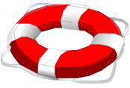
Life Jackets
Type IV:
Throwable
What size vessel must carry these on aboard?
Copyright 2019 - Coast Guard Auxiliary Association, Inc.
Notes:
Instructor Notes:
ASK: the question on the slide
Vessels 16’ and over must have at least one

Slide 27
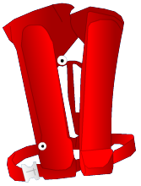
Life Jackets
Type V:
Inflatable
Minimum buoyancy 22 pounds
Copyright 2019 - Coast Guard Auxiliary Association, Inc.
Notes:
Instructor Notes:
V/III: Type V device that provides Type III performance when worn.
ASK:
What are the advantages of an inflatable?
What are the disadvantages?
Who may NOT wear them?
Children 16 and under
Are all inflatables Coast Guard Approved?
Type V must be worn to be counted in meeting number of PFDs required on board

Slide 28
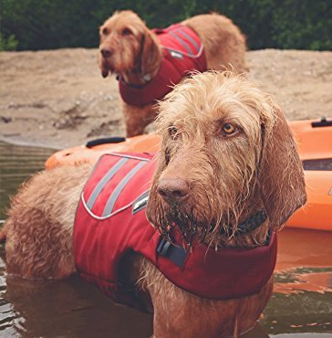
Life Jackets
How about one for
your best friend and
hunting partner
Copyright 2019 - Coast Guard Auxiliary Association, Inc.
Notes:
Instructor Notes: Not a legal requirement

Slide 29
Life Jackets
New Life Jacket Labels
Choose the level of buoyancy for the type of activity.
The curved arrow indicates that it is likely to turn an unconscious wearer face up in the water
Copyright 2019 - Coast Guard Auxiliary Association, Inc.
Notes:
The new buoyancy levels are based on “Newtons”, which is a math calculation used by Sir Issac Newton. These levels include:
• Level 50 for paddle board use or use close to shore where help is likely to happen quickly.
• Level 70 for inflatables, active wear, with help nearby.
•Level 100 provides more performance than the Level 70, better buoyancy.
• Level 150 - off shore use where help Is not likely for some time. This device will keep you face up.
•Level 275 heavier duty for commercial and industrial use.
The labels will also indicate whether for use by Adults, Youth, Toddler, or Infants. You will also need to look at the weight and chest measurements for best fit. The choice of buoyancy will be an individual's, not mandatory.
The use of the curved-arrow icons will indicate how effective the life jacket will turn a person face up or not.

Slide 30
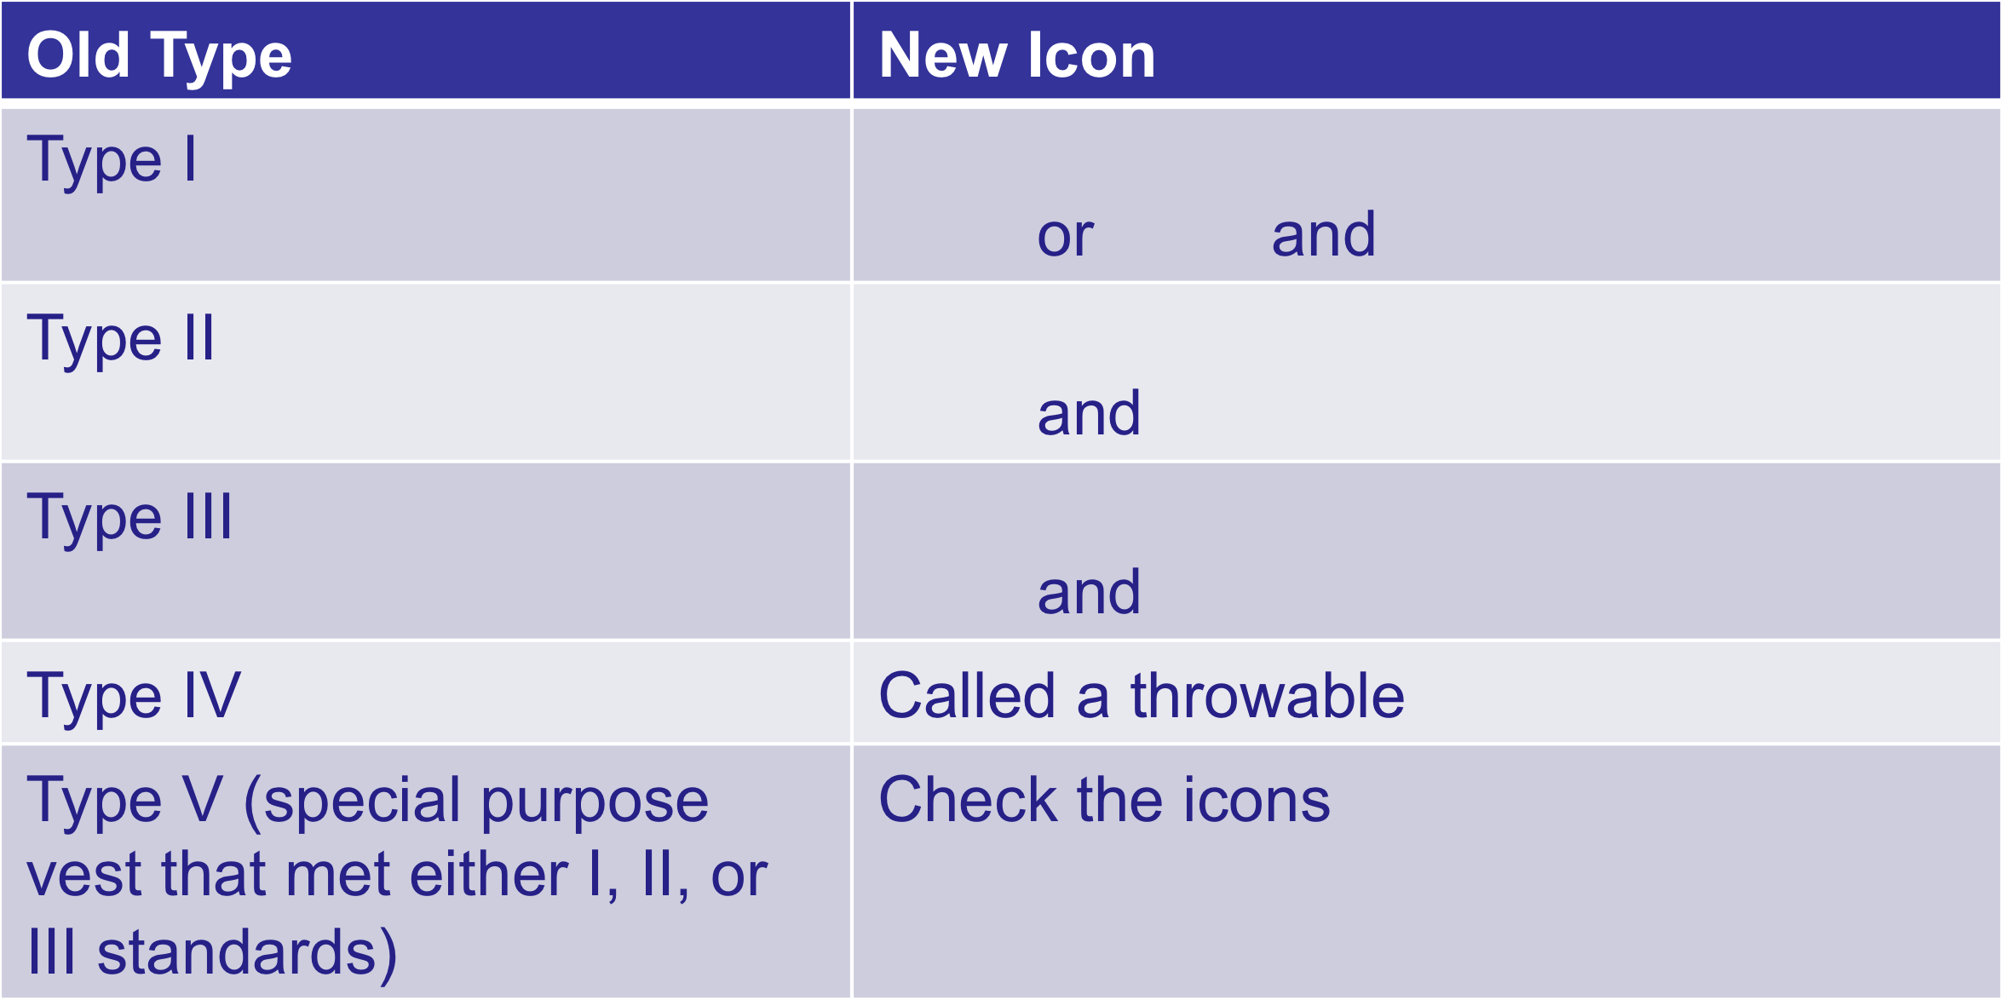
Life Jackets
Comparison of Labels
Copyright 2019 - Coast Guard Auxiliary Association, Inc.
Notes:
The new buoyancy levels are based on “Newtons”, which is a math calculation used by Sir Issac Newton. These levels include:
• Level 50 for paddle board use or use close to shore where help is likely to happen quickly.
• Level 70 for inflatables, active wear, with help nearby.
•Level 100 provides more performance than the Level 70, better buoyancy.
• Level 150 - off shore use where help Is not likely for some time. This device will keep you face up.
•Level 275 heavier duty for commercial and industrial use.
The labels will also indicate whether for use by Adults, Youth, Toddler, or Infants. You will also need to look at the weight and chest measurements for best fit. The choice of buoyancy will be an individual's, not mandatory.
The use of the curved-arrow icons will indicate how effective the life jacket will turn a person face up or not.

Slide 31
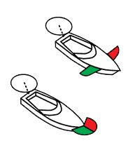
Lights
Always on at night, or poor visibility (weather)
Always use your anchor light if anchored
Copyright 2019 - Coast Guard Auxiliary Association, Inc.
Notes:
Instructor Notes:
Remind all that a flashlight should be aboard all boats.

Slide 32
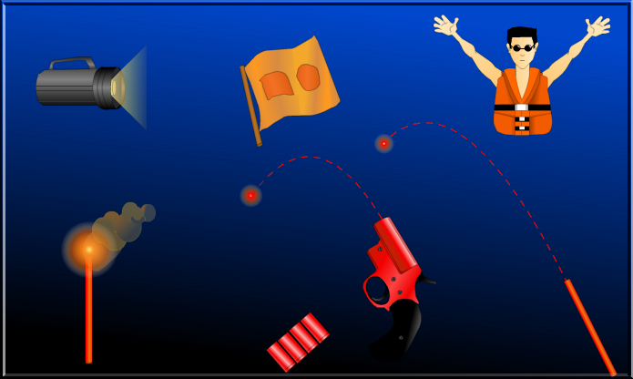
Visual Distress Signals
Copyright 2019 - Coast Guard Auxiliary Association, Inc.
Notes:
Instructor Notes:
Use visual distress signals if you see other vessel

Slide 33
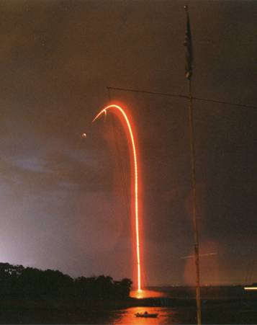
Visual Distress Signals
How many?
What kind?
Who must carry them?
Copyright 2019 - Coast Guard Auxiliary Association, Inc.
Notes:
Instructor Notes:
ASK: the questions on the slide
Pyrotechnic: 3 good for night and day and not past expiration date
Non-pyro: electric SOS light and 3 day (smoke) or orange flag
All boats on coastal waters or operating at night

Slide 34
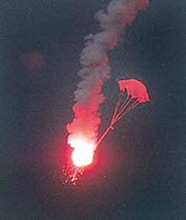
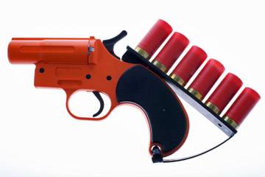
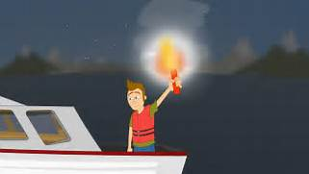
Visual Distress Signals
Day or Night Use
Check Local Laws
Copyright 2019 - Coast Guard Auxiliary Association, Inc.
Notes:
Instructor Notes: Parachute Flare, Meteor Flare, Flare Gun (shoots either P or M Flares)(12 gage or 20mm), Hand Held Flare
Remind students that pyrotechnic devices have a service life of 42 months.
Pyrotechnics must be USCG approved & in date. Explain that pyrotechnic devices may not be legal in all areas where there are dry woodland areas or homes nearby. CHECK LOCAL RESTRICTIONS AND LAWS.

Slide 35
Visual Distress Signals
Always Check Local Regulations
Where You Plan to Hunt
Copyright 2019 - Coast Guard Auxiliary Association, Inc.
Notes:
In most river and lake areas where water way is less than 2 miles wide from shore, VDS are not required. ALWAYS CHECK LOCAL REGULATIONS WHERE YOU PLAN TO HUNT.

Slide 36
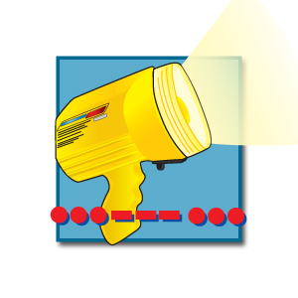
Visual Distress Signals
Night Only Use
SOS Flashlight
Copyright 2019 - Coast Guard Auxiliary Association, Inc.
Notes:
Instructor Notes: SOS Flashlight

Slide 37
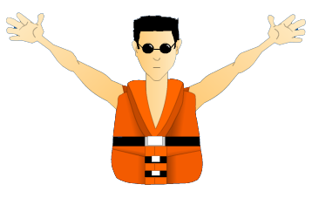
Visual Distress Signals
Day Only Use
Not USCG approved
Copyright 2019 - Coast Guard Auxiliary Association, Inc.
Notes:
Instructor Notes: Orange Flag, Hand Held Smoke, Floating Smoke (need total of 3 smokes or 1 flag)
Waving Arms (palms out) (Not USCG Approved)
Boats less than 16 feet don’t need day signals.

Slide 38
Visual Distress Signals
Copyright 2019 - Coast Guard Auxiliary Association, Inc.
Notes:
New Electronic Flares. Current USCG approved electronic flares from Weems and Plath or from Orion. Most kits include a flag for Day use VDS. Only need one of these on board instead of three traditional flares, non-toxic. Can usually be purchased from anywhere from $59.99 to $99.99 depending on location and vendor.

Slide 39
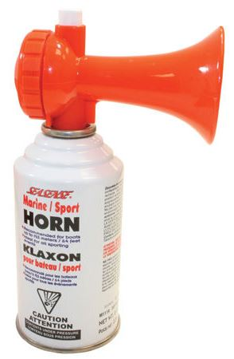
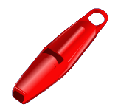
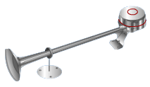
Sound Producing Devices
Boats <12 (39.4 ft.) meters must carry a
whistle or horn
Copyright 2019 - Coast Guard Auxiliary Association, Inc.
Notes:
Instructor Notes: ASK: how loud the whistles or horn must be?
Audible ½ mile

Slide 40
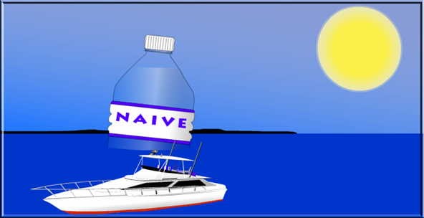
Avoid Dehydration
Has anyone ever experienced dehydration?
How can dehydration be avoided?
Copyright 2019 - Coast Guard Auxiliary Association, Inc.
Notes:
Instructor Notes:
If a class member has experienced dehydration, ask them to explain what it was like.
If no one responds, ask students what causes are.

Slide 41
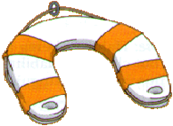
Man Overboard
Reduce speed
Throw PFD
Point to victim
Turn boat around
Approach from downwind
Stop engine
Pull aboard
Copyright 2019 - Coast Guard Auxiliary Association, Inc.
Notes:
Instructor Notes:
Discuss why each item is important. Remind the participants that the first person to see someone go overboard should shout so loudly, ensuring the helmsman hears and keep pointing to person in water so they don’t loose sight of them.

Slide 42
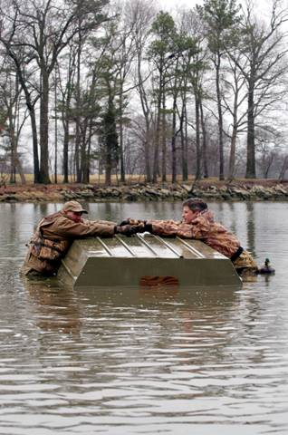
Capsizing and Swamping
Don’t overload
the boat.
Control turns.
Anchor from the
bow only.
Stay with boat.
Try to re-board.
Copyright 2019 - Coast Guard Auxiliary Association, Inc.
Notes:
Instructor Notes:
Discuss why each point is important. Get as much of body out of water as you can. Waders full of water will make it harder to get out of the water.

Slide 43
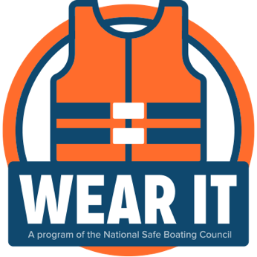
If You Go Into the Water
Review the four stages of cold water immersion
Cold water can kill – WEAR your life jacket
Copyright 2019 - Coast Guard Auxiliary Association, Inc.
Notes:
Instructor Notes:
Discuss how cold water immersion kills.
Stress:
Stage 1: Initial cold shock- the immediate reaction to gasp in a breath
Stage 2: Short term “swim failure”
Stage 3: Long term immersion hypothermia
Stage 4: Post-immersion collapse
Discuss what happens in each stage.
WEARING A PFD can mean surviving cold water immersion and the initial cold shock. Even excellent swimmers are affected by cold water immersion.

Slide 44
Hypothermia Can Cause Death
What are some of the symptoms?
Shivering
Bluish lips and fingers
Loss of feeling in hands and feet
Cold bluish skin
Decreased mental skills
Slurred speech and blurred vision
Rigidity in hands and feet
Unconsciousness
Coma
Copyright 2019 - Coast Guard Auxiliary Association, Inc.
Notes:
Instructor Notes:
Ask the question. Look for these answers:
Shivering
Bluish lips and fingers
Loss of feeling in hands and feet
Cold bluish skin
Decreased mental skills
Slurred speech and blurred vision
Rigidity in hands and feet
Unconsciousness
Coma

Slide 45
Hypothermia Can Cause Death
Hypothermia Chart
Water Exhaustion or Survival
Temp (ºF) Unconsciousness Time
32.5º-40º 15-30 min 30-90 min
40º-50º 30-60 min 1-3 hrs
50º-60º 1-2 hrs 1-6 hrs
60º-70º 2-7 hrs 2-40 hrs
70º-80º 3-12 hrs 3 hrs-indefinite
Copyright 2019 - Coast Guard Auxiliary Association, Inc.
Notes:
Instructor Notes:
Ref: Nautical Know How, Inc. (Boatsafe.com web page)
Remind students that water temperature at time of the two accidents was about 50 degrees. Point out that part of table.

Slide 46
Hypothermia
Get as much of body out of water as possible
Water removes body heat faster than air
Swim only if land close
Exertion uses up body heat
Stay with boat
Copyright 2019 - Coast Guard Auxiliary Association, Inc.
Notes:
Instructor Notes:
Discuss why each point is important.
Get as much of body out of water as you can.
Waders full of water will make it harder to get out of the water.

Slide 47
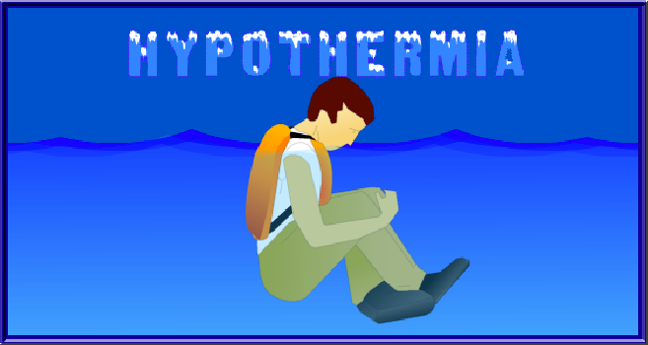
Help Escape Lessening Position
Reduces exposure of high heat loss areas of body
Copyright 2019 - Coast Guard Auxiliary Association, Inc.
Notes:
Instructor Notes:
Discuss the definition of hypothermia and why this slide will help.
Hypothermia is reduced body temperature that happens when a body dissipates more heat than it absorbs. In humans, it is defined as a body core temperature below 35.0 °C (95.0 °F).
If you are wearing a Type 3 life jacket, you WILL be turned face down if assuming the HELP position.

Slide 48
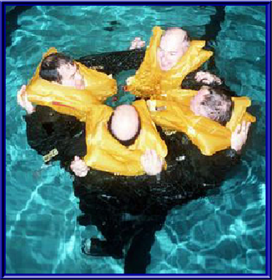
Huddle Position
What are the advantages of the
“huddle” position?
Copyright 2019 - Coast Guard Auxiliary Association, Inc.
Notes:
Instructor Notes:
Ask the question and stress:
Reduces Body Heat Loss
Provides Moral Support

Slide 49
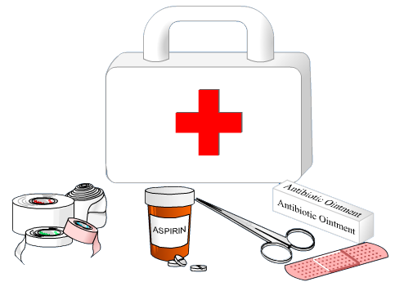
Know How to Handle Injuries
Maintain First Aid Kit
Copyright 2019 - Coast Guard Auxiliary Association, Inc.
Notes:
Instructor Notes:
Classroom aid: Bring a well-stocked first aid kit to demonstrate the materials that are basic to first aid.
Stress that the first aid kit needs to be checked monthly to assure that mold and mildew are not affecting the contents.
Stress replacing supplies if used.

Slide 50
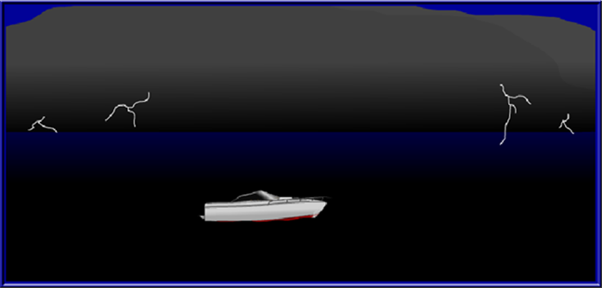
Weather
Check weather on VHF-FM radio
WX-1 WX-2 WX-3 WX-4 WX-5
WX-6 WX-7
National Wx Service online: weather.gov
What are some signs that the weather is deteriorating?
Copyright 2019 - Coast Guard Auxiliary Association, Inc.
Notes:
Instructor Notes:
Stress:
Always check weather forecast before you go
Be alert to weather changes
Watch for wind shift
Watch for rough water
Observe weather from all directions.

Slide 51
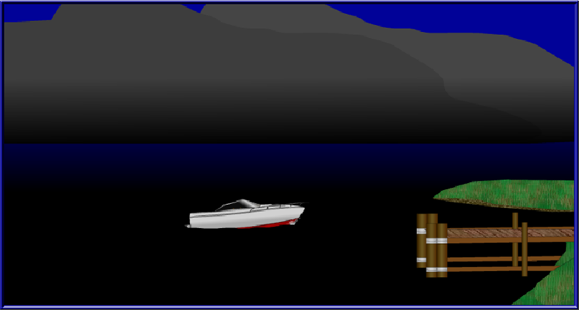
When Caught in Bad Weather
What can you do if you are caught
in bad weather?
Copyright 2019 - Coast Guard Auxiliary Association, Inc.
Notes:
Instructor Notes:
Stress:
Put on PFD- if not already on
Reduce speed
Consider seeking shelter
Close hatches and portholes
Keep weight low

Slide 52
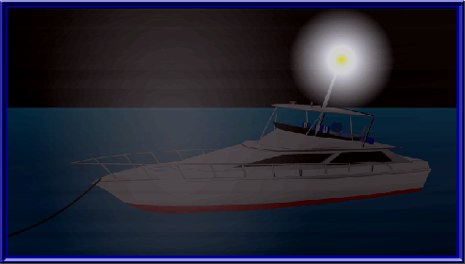
When Caught in Fog?
What should you do?
Copyright 2019 - Coast Guard Auxiliary Association, Inc.
Notes:
Instructor Notes:
Stress:
Know your position (location)
Turn on navigation lights
Reduce speed
Use sound signals
Post lookouts
Put on PFD

Slide 53
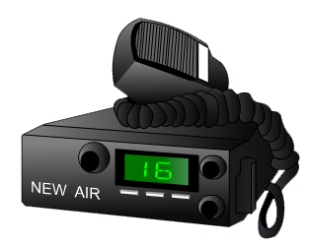
To Get Help
Marine VHF channel 16
International distress, safety, and calling.
Widely monitored by USCG, stations, and
other vessels.
Copyright 2019 - Coast Guard Auxiliary Association, Inc.

Slide 54
Distress, Urgency, & Safety Messages
What radio call would you use for the
Following situations?
Distress (life-threatening):
Mayday, Mayday, Mayday
Urgency (mechanical, medical):
Panpan, Panpan, Panpan
Safety (navigational, weather):
Sécurité, Sécurité, Sécurité
Copyright 2019 - Coast Guard Auxiliary Association, Inc.
Notes:
Instructor Notes:
Distress:
MAYDAY, MAYDAY, MAYDAY
Urgency:
PANPAN, PANPAN, PANPAN
Safety:
SECURITE, SECURITE, SECURITE

Slide 55
Hunting
What are some safety considerations
while hunting from a boat?
Copyright 2019 - Coast Guard Auxiliary Association, Inc.
Notes:
Instructor Notes:
ASK: Can each of you comment about safety considerations while hunting from a boat?
FACT: Second leading cause of death among hunters is drowning according to the National Rifle Association.

Slide 56
Safety Considerations
While underway, you are a boater
as well as a hunter
Required to obey boating laws
and regulations
Small flat-bottom boats more prone
to capsizing
Balance load in boat – do not overload
Copyright 2019 - Coast Guard Auxiliary Association, Inc.

Slide 57
Safety Considerations
Use well trained dogs that are used to
working from a boat
Cold water immersion is always a
consideration
Dress appropriately
Wear a life jacket suitable for hunting
Keep it on at all times
No drugs or alcohol
Copyright 2019 - Coast Guard Auxiliary Association, Inc.

Slide 58
Safety Considerations
Be aware of weather and stay close
to shore.
Don’t shoot from a moving boat.
Firearms are unloaded while the boat
is moving.
Point muzzle in safe direction.
Treat every firearm as if it is loaded.
Copyright 2019 - Coast Guard Auxiliary Association, Inc.

Slide 59
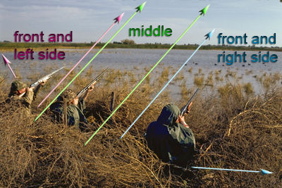
Shooting Zones
Copyright 2019 - Coast Guard Auxiliary Association, Inc.
Notes:
Image from TPWD web site

Slide 60
Shooting Zones
Establish shooting zones before you start to shoot.
Be sure everyone understands where their zone is located.
No shooting outside your assigned zone—NO EXCEPTIONS
Copyright 2019 - Coast Guard Auxiliary Association, Inc.

Slide 61
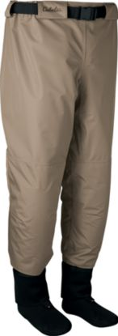
Waders
Waist
Belt
Copyright 2019 - Coast Guard Auxiliary Association, Inc.
Notes:
Instructor Notes: Several different styles, materials and material thicknesses.
Waist belt helps keep water from going into legs.

Slide 62
Waders
Submersion above top may let water fill legs and boots.
While this won’t pull you under water, it will make getting out of water difficult.
Without waist belt, the current may cause waders to fill with water and act like a parachute, dragging you with it.
Copyright 2019 - Coast Guard Auxiliary Association, Inc.

Slide 63
Waders
5mm neoprene waders with thick boots may actually cause your feet and legs to float making it difficult to get your feet back under you and may make it hard to keep head out of water.
A life jacket will help keep you head out of water.
Copyright 2019 - Coast Guard Auxiliary Association, Inc.

Slide 64
Waders
Immerse yourself with your waders on in a swimming pool (in warm weather) to see how your waders behave.
Have a friend with a life jacket on in the pool to help you if you get into trouble.
Try your waders with your life jacket on too.
Copyright 2019 - Coast Guard Auxiliary Association, Inc.

Slide 65
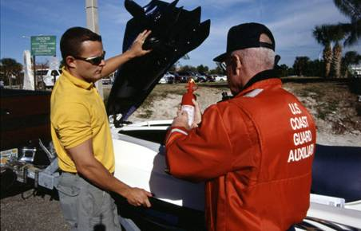
Vessel Safety Check
USCG Auxiliary Vessel Safety Check
Free Courtesy Safety Check
Ensures your vessel meets or exceeds federal & state standards
Copyright 2019 - Coast Guard Auxiliary Association, Inc.

Slide 66
When Offered, Take a Hunting Education Class
Copyright 2019 - Coast Guard Auxiliary Association, Inc.

Slide 67
Always Wear Your Life Jacket
Copyright 2019 - Coast Guard Auxiliary Association, Inc.

Slide 68
For More Information:
USCG Auxiliary (www.cgaux.org)
Boating Tips for Hunters and Anglers (www.sas.usace.army.mil)
9 Cold-water Survival Tips You Need to Know (www.nrafamily.org)
BoatUS Foundation (www.boatus.com)
NRA Hunting Programs Site (hservices.nra.org)
Hunter-Ed (www.hunter-ed.com)
Copyright 2019 - Coast Guard Auxiliary Association, Inc.

Slide 69
Thank you for your Attention Have fun and Be Safe
Copyright 2019 - Coast Guard Auxiliary Association, Inc.

